Slide 1

Introduction to OGC API - Common|
<Presenter Name>
September 23rd, 2020
#OGCAPI
Sprint Sponsored by

Slide 2
Welcome
OGC API-Common is a family of standards
Core (mature draft)
Geospatial Data (in-work)
Crs (proposed)
Others as identified
This family of standards define API modules which can be used to build OGC conformant Web APIs.

Slide 3
Part 1: Core

Slide 4
Scope
The Core provides a foundation upon which a conformant OGC Web API can be built. That foundation includes:
Common resources
Description of the API
Conformance classes

Slide 5
The Landing Page
The starting point for navigating an API
Returned by “GET /”
Provides links to
The `API definition` (path `/api`),
The `Conformance` statements (path `/conformance`),
Landing Page Schema
Example

Slide 6
API Definition
Provides a detailed description of the API
Returned by:
“GET /api”
Following the “service-desc” link from the landing page OR
Following the “service-doc” link from the landing page
Only OpenAPI 3.0 is currently supported
Other options may be added in the future
OpenAPI Introduction
Example

Slide 7
Conformance
Identifies the conformance classes supported by this API
Returned by:
“GET /conformance”
Following the “conformance” link from the landing page
Returned document is a list of URIs for the conformance classes
Conformance Schema
Example

Slide 8
Part 2: Geospatial Data

Slide 9
Scope
This standard provides a common connection between the API landing page and resource-specific details. That connection includes metadata which describes the hosted resources, common parameters for selecting subsets of the hosted resources, and URI templates for identifying the above.
Remember:
This standard is still in-work.
This is a separate conformance class from the Core.

Slide 10
Geospatial Data
The starting point for the resource-specific paths
Returned by:
“GET /collections”
Following the “data” link from the landing page
Returned document contains:
A link to itself
A link to each alternate encoding of the document
An array of Collection Metadata records
Collections Schema
Example

Slide 11
Collection Metadata
Describes a collection
Included in the Collections response
Also returned by:
“GET /collections/{collectionId}”
Metadata includes:
A local identifier for the collection that is unique for the dataset
A list of coordinate reference systems (CRS) in which geometries may be returned by the server
An optional title and description for the collection
An optional extent that can be used to provide an indication of the spatial and temporal extent of the collection - typically derived from the data.
Collection Metadata Schema
Example

Slide 12
Extent
Defines a spatial-temporal boundary for the collection
Spatial extent is a bounding box.
Temporal extent is a date-time or a period.
May include spatial and temporal CRS.
Extent Schema

Slide 13
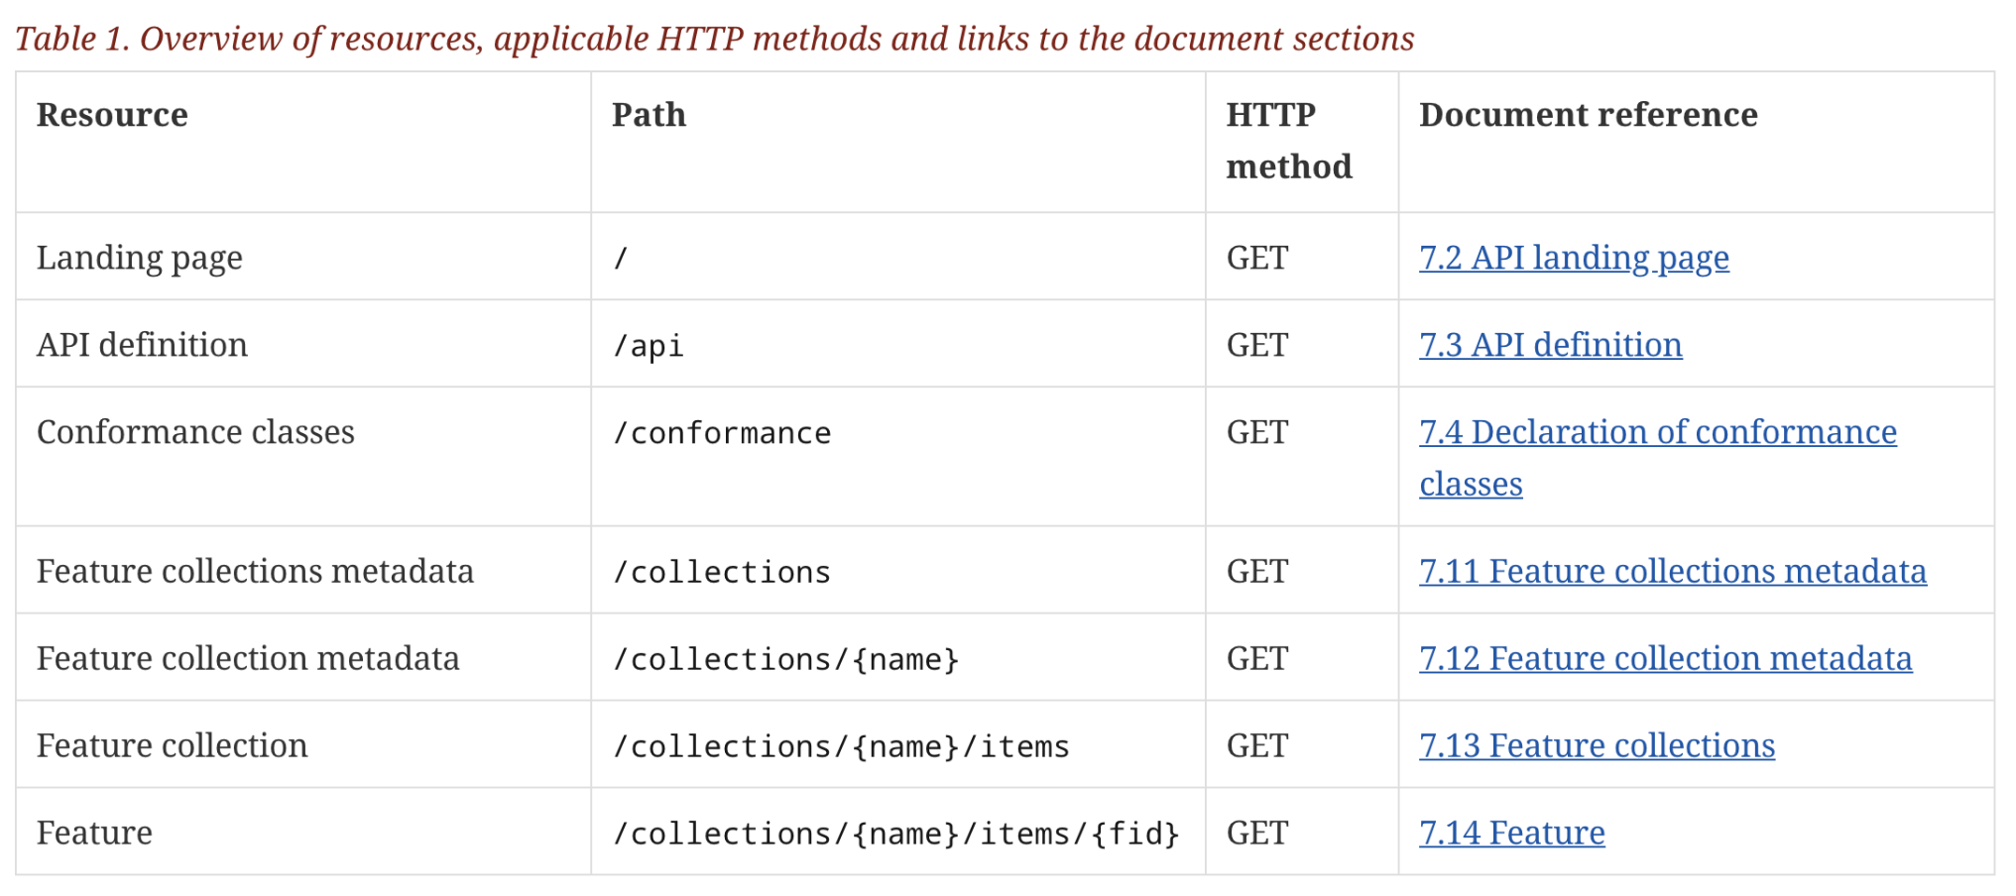
Example: OGC API - Features
information
about the API
a dataset with a sub-division into
named collections of features
the features
Only the feature resources are specific to a “feature service”

Slide 14
Hot Button Issues
Do we support static Web API Servers?
Simple file stores without support for parameters
Answer: Yes, but it may need to be a separate Conformance Class
Is API-Common Core mandatory?
Answer: No
An OGC Web API needs to have a “root node” but it does not have to be API-Common Core
This allows an OGC API to be “plugged into” an existing API
Conformance granularity
What is the granularity of the conformance classes for an OGC Web API?
For example – can an individual parameter be a conformance class?
Answer: As course as possible without unduly limiting implementations.
How many dimensions for a Bounding Box?
Answer: up to four
Bbox supports up to three depending on the CRS uses
DateTime is the fourth
Note: the subsetting capability from API-Coverages is to be considered for Common.

Slide 15
Community
500+ International Members
110+ Member Meetings
60+ Alliance and Liaison partners
50+ Standards Working Groups
45+ Domain Working Groups
25+ Years of Not for Profit Work 10+ Regional and Country Forums
Slides by:
Chuck Heazel
cheazel@heazeltech.com
Innovation
120+ Innovation Initiatives
380+ Technical reports
Quarterly Tech Trends monitoring
Standards
65+ Adopted Standards
300+ products with 1000+ certified implementations
1,700,000+ Operational Data Sets Using OGC Standards
Contact info@ogc.org to schedule a meeting for an in-depth discussion with OGC staff and join our community today!
Notes:
If you have any questions, do not hesitate to reach out to OGC or schedule a follow-up. We’re working constantly to change the landscape of location information and want to help your organization get where it needs to go.

